Slide 1
Churn Rate Analysis
Data Mining Project

Slide 2
Significance of Churn Rate
Churn rate is a critical metric for stakeholders as it indicates the percentage of customers who stop using the company's services over a given period. High churn rates can indicate customer dissatisfaction, poor service quality, or better offers from competitors. For MCI, understanding churn rate helps in identifying areas of improvement and implementing strategies to retain customers.

Slide 3
Characteristics of Churned and Non-Churned Customers
Distribution of Churned and Non-Churned Customers:
Characteristics of Churned Customers:
Characteristics of Non-Churned Customers:
Analysis of Categorical Features:

Slide 4
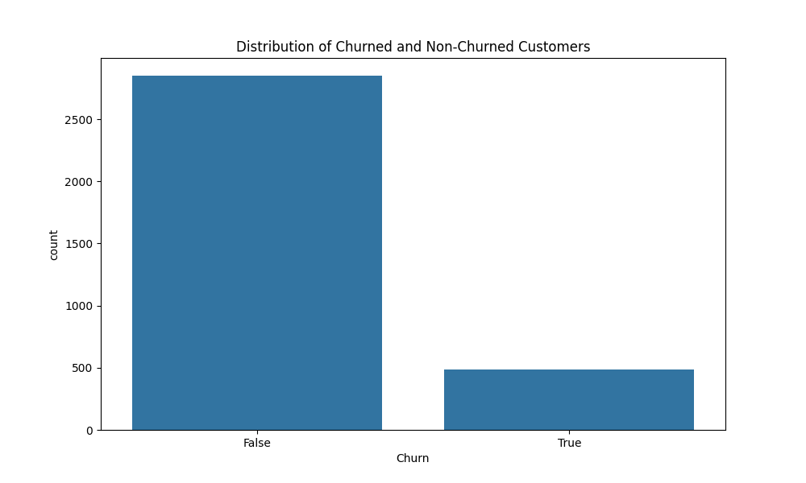
Distribution of Churned and Non-Churned Customers

Slide 5
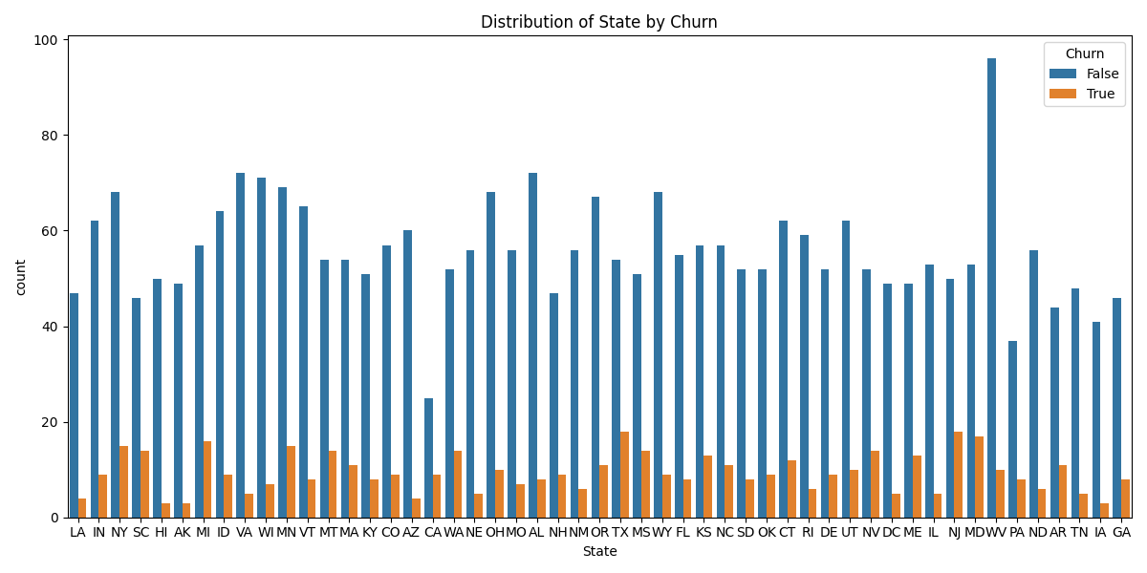
Distribution of State by Churn

Slide 6
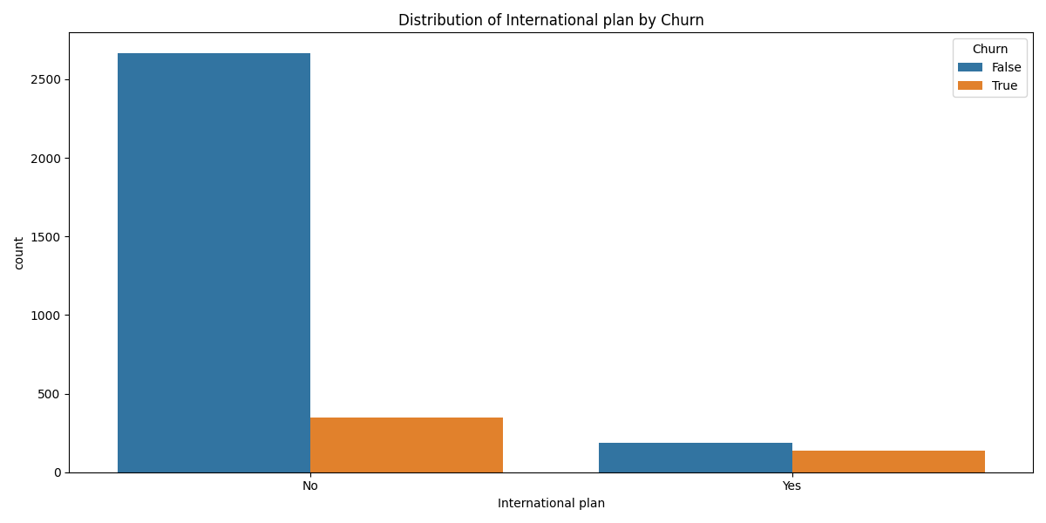
Distribution of International plan by Churn

Slide 7
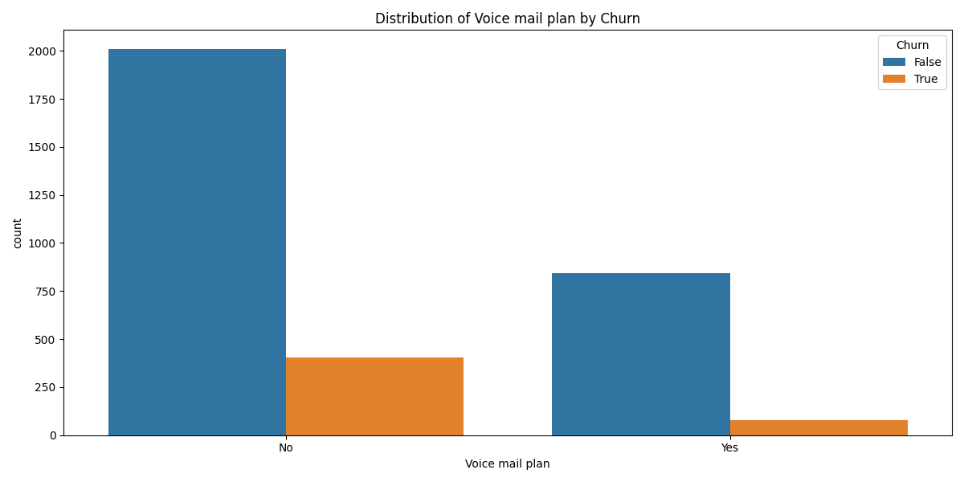
Distribution of Voice mail plan by Churn

Slide 8
ML Modeling
Data Preprocessing:
Split the Data into Training and Testing Sets:
Standardize the Features:
Train a Logistic Regression Model:
Predict and Evaluate the Model:
Feature Importance:

Slide 9
Actions to Enhance Retention Rate
1. Qualitative Analytics: Conduct customer surveys and feedback sessions to understand the reasons behind churn. Use this information to improve customer service and address pain points.
2. Quantitative Analytics: Analyze customer usage patterns and identify early warning signs of churn. Implement targeted marketing campaigns and personalized offers to retain at-risk customers.

